Slide 1
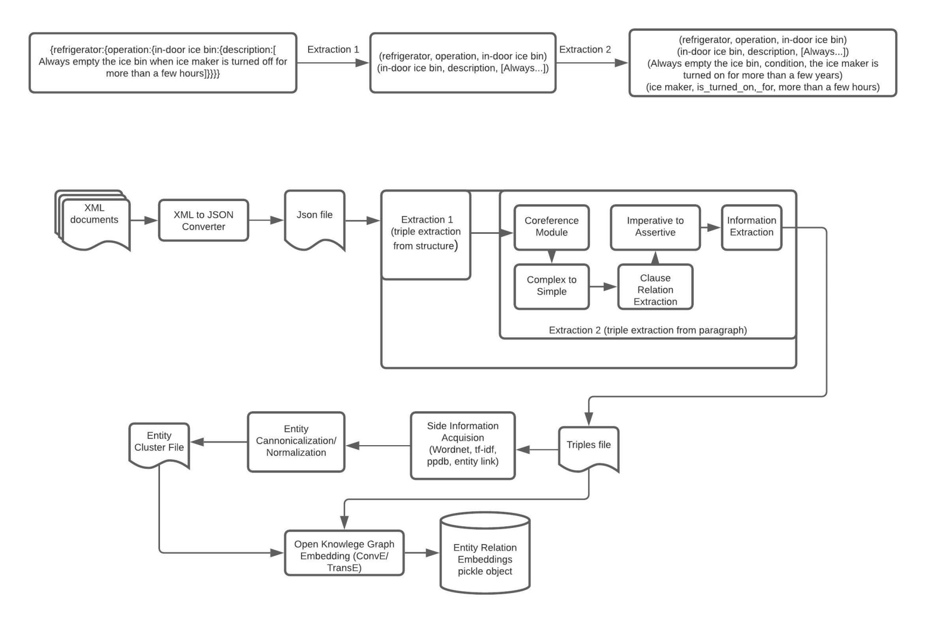
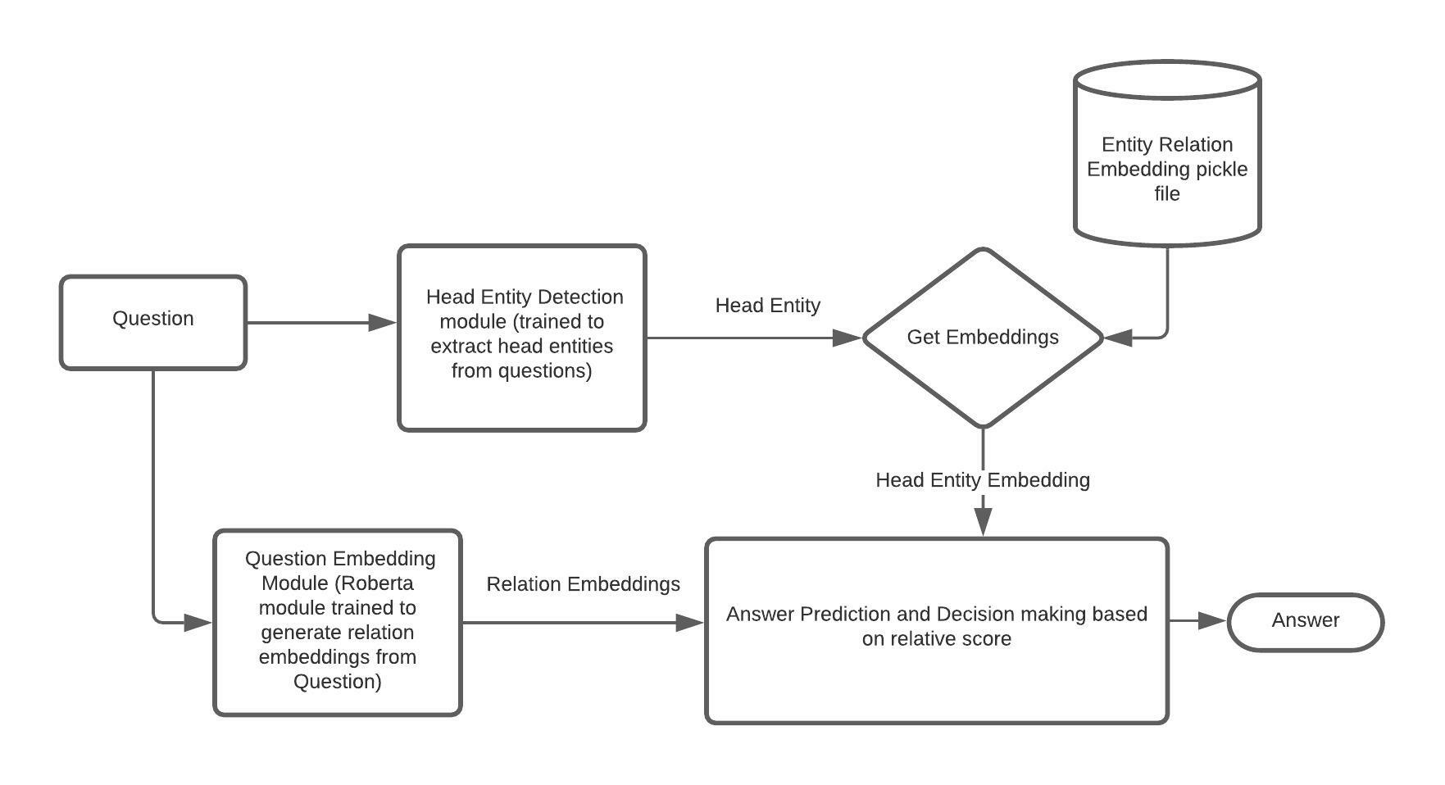
1. LG Manual - Extraction Pipeline and QA Inference
Info
1 / 7

